Slide 1
Web Engineering
Introduction to Javascript
Lecture 04

Slide 2
What is JavaScript?
A programming language specifically designed to work with Web browsers
It is designed to used for developing small programs – called scripts – that can be embedded in HTML Web pages
JavaScript:
Is an interpreted language
Supports event-driven programming
Is object-based language

Slide 3
HTML
CSS
JavaScript
markup language
style sheet language
programming language
content
presentation
behavior

Slide 4
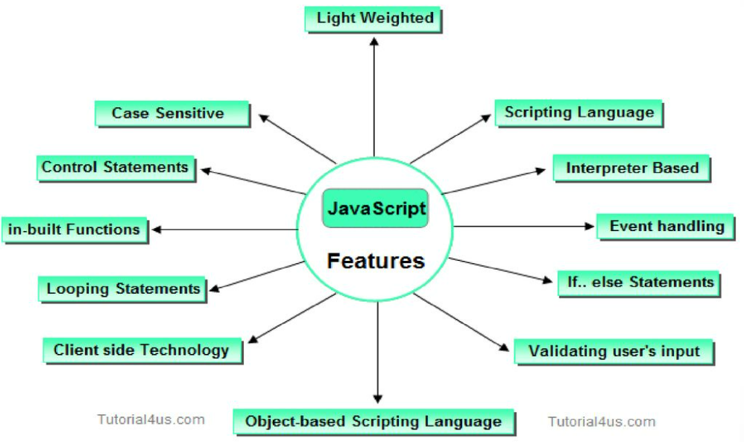
What is JavaScript?

Slide 5
Advantages of Client-Side Scripting
Reduced server load as it does not have to send messages to the user’s browser about missing or incorrect data
Reduced network traffic as the form’s data is sent only once instead of many to’s and fro’s
JavaScript provides various interfaces to developers for creating catchy webpages. Drag and drop components or sliders may give a rich interface to the webpages. This leads to improved user-interactivity on the webpage.

Slide 6
Disadvantages
Client-side scripts do not work with all browsers
Some user intentionally turn scripting off or disabled on their browsers
This increases the complexity of the Web page, as it now has to support both situations: browsers with scripting capability, and those not having that capability

Slide 7
Some of the things that JavaScript can do!
Control the appearance of the browser.
Control the content and appearance of the document displayed in the browser
Interact with the user through event handlers
calculations, including floating-point ones
Store & modify a limited amount of data about the user in the form of client-side “cookies”

Slide 8
Case Sensitivity
HTML is not case sensitive. The following mean the same to the browser:
<HTML> -- <html>
<Html> -- <htMl>
JavaScript is case sensitive. Only the first of the following will result in the desired function – the rest will generate an error or some other undesirable event:
onMouseClick -- OnMouseClick
onmouseclick -- ONMOUSECLICK
alert(“hello world”);
Alert(“hello world”);

Slide 9
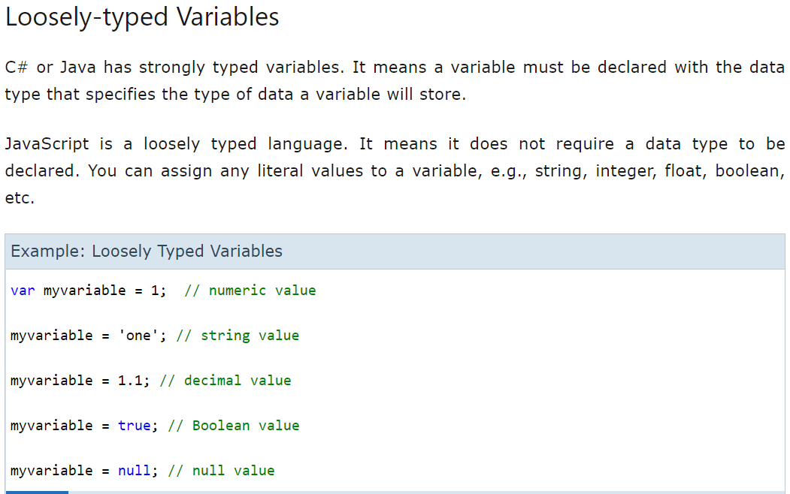
Variables in JS
variables are usually declared with the var keyword
(case sensitive)

Slide 10
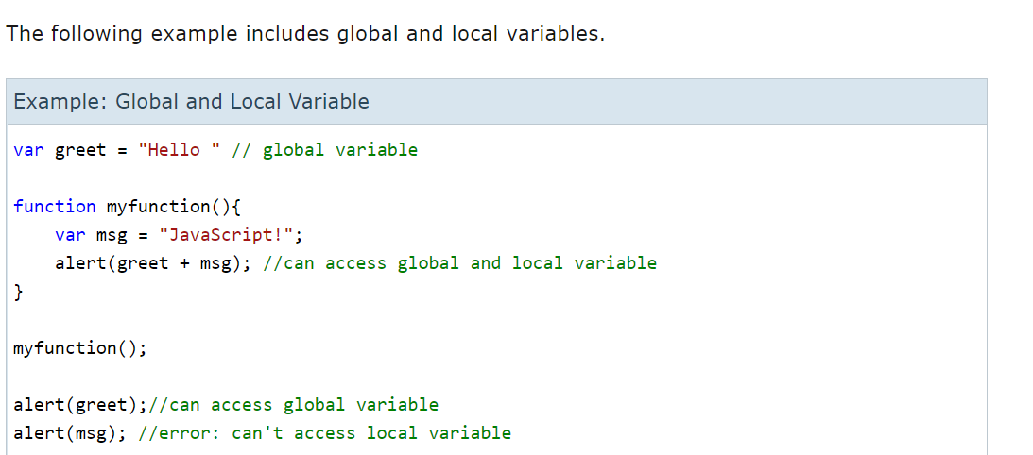
Variables in JS

Slide 11
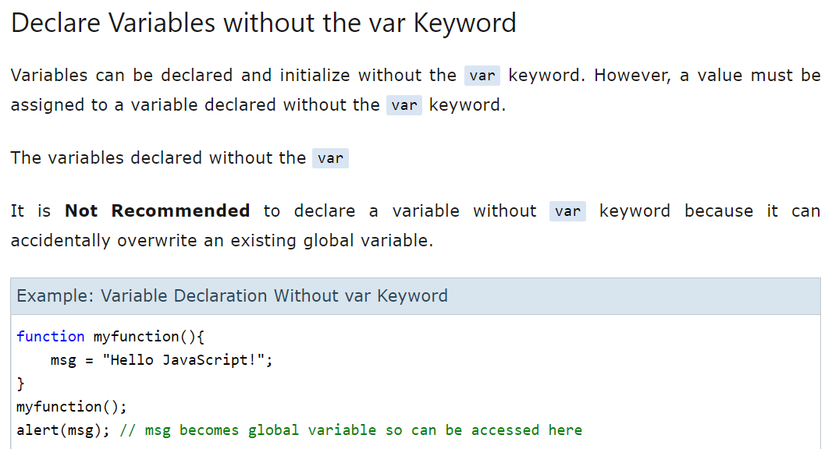
Variables in JS

Slide 12
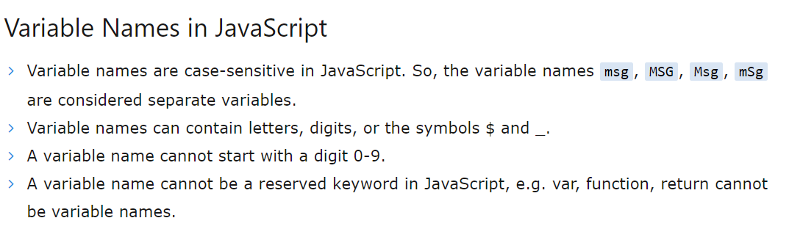
Variables in JS

Slide 13
Variables in JS
Generally, the var keyword is used to declare a JavaScript variable. Const is another keyword to declare a variable when you do not want to change the value of that variable for the whole program.
Variable define using const keyword cannot be reassigned, or its value cannot be changed.
The const variable must be initialized at the time of declaration with the variable name, e.g., const x=6;
You cannot provide the value to the variable after declaration.
The value of the const variable cannot be changed.

Slide 14
JavaScript Operators
Operators operate on operands to achieve the desired results
JavaScript has numerous operators, classified in many categories. We will look at only a few of them belonging to the following categories:
--Arithmetic operators (+, -, * , /, %)
--Relational operators (>,>=,<,<=,==,!=)
Logical Operators
Assignment Operators

Slide 15
Comments in JS
identical to C++/Java comment syntax
Comment syntaxes in
HTML: <!-- comment -->
C++/CSS/JS/PHP: /* comment */, multi-line
C++/Java/JS/PHP: // comment, single line
PHP: # comment

Slide 16
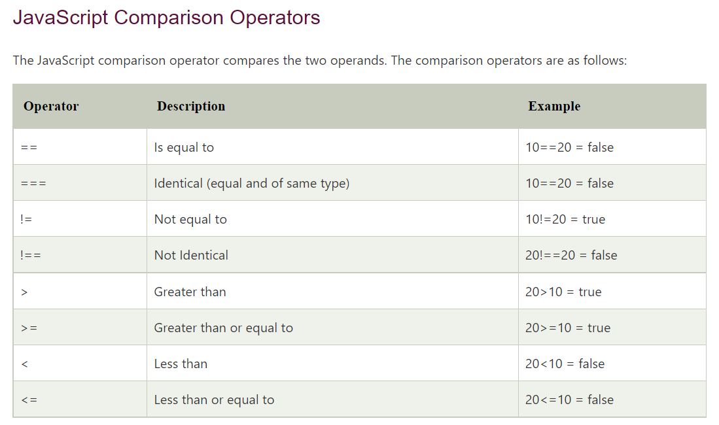
JavaScript Operators

Slide 17
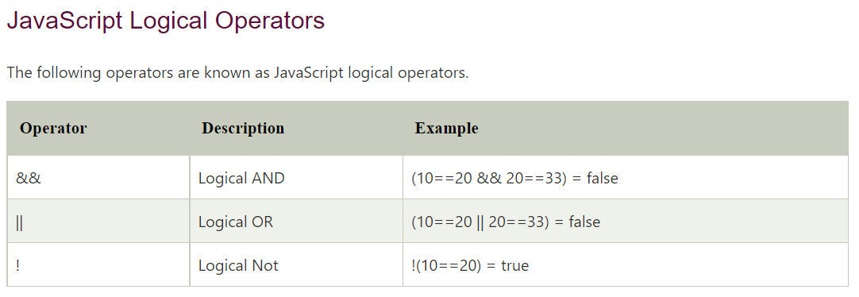
JavaScript Operators

Slide 18
Rules of Naming variable- Identifiers
Identifiers are names used by JavaScript to refer to variables ( as well as objects, properties, methods, and functions!)
An identifier must begin with an alphabetical character (a-z or A-Z) or the underscore “_” character
Subsequent characters can be an alphabetical (a-z or A-B) or numeric character (0-9) or an underscore
Don’t not name variables with keywords like While
Wrong
1stStreet
number One
5
test@gmail
Right
Street1
numberOne

Slide 19
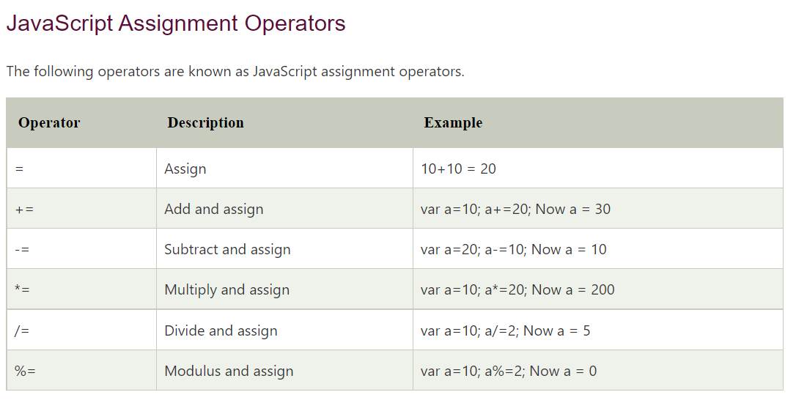
JavaScript Operators

Slide 20
A few more methods associated with the “window” object
alert()
confirm()
prompt()
close()
open()
focus()
blur()
setTimeOut()
setInterval()

Slide 21
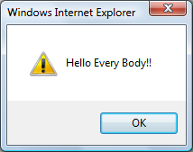
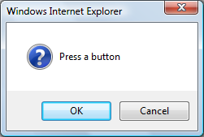
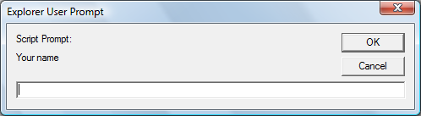
Popup Boxes
Alert Box
window.alert(“Hello Every body!!");
Confirm Box
window.confirm("Press a button");
Prompt Box
window.prompt(“Your name","")

Slide 22
Example
Var x=0;
Var y=1;
if ( x || y )
document.write (“Either or both are true”);
else
document.write (“Both are false”);

Slide 23
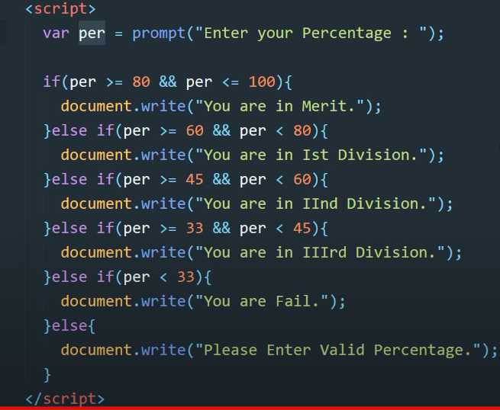
Calculating Grade in JS

Slide 24
for: Example
for ( x = 99 ; x < 6000 ; x = x + 1 ) {
document.write ( x ) ;
}
=============
for ( x = 6000 ; x > 0 ; x = x - 1 )
{
document.write ( x ) ;
}
How many iterations would this ‘for’ loop run for?

Slide 25
while loops (same as C++)
while (condition) {
statements;
} JS
do {
statements;
} while (condition); JS
break and continue keywords also behave as in C++/Java

Slide 26
Arrays in JavaScript
In JavaScript, arrays are implemented in the form of the ‘Array’ object
The key property of the ‘Array’ object is ‘length’, i.e the number of elements in an array
Two of the key ‘Array’ methods are:
reverse( )
sort( )
Elements of an array can be of any type

Slide 27
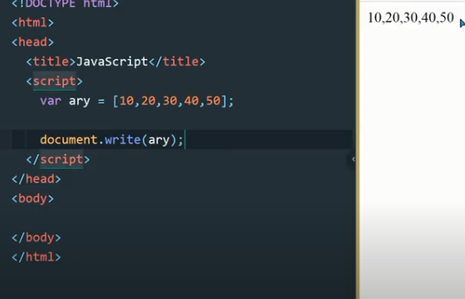
Array (continue)

Slide 28
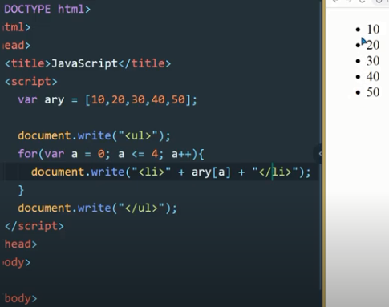
Use of List in JS Loop

Slide 29
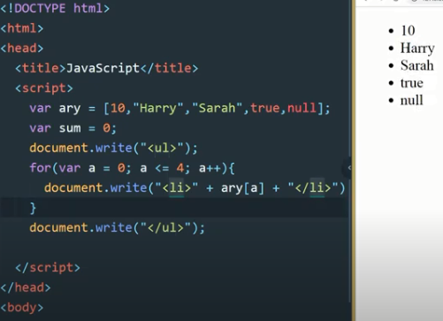
JS array can store different types of data

Slide 30
student = new Array( 4 ) ; //array declaration
student[ 0 ] = “Waseem” ;
student[ 1 ] = “Waqar” ;
student[ 2 ] = “Saqlain” ;
student[ 3 ] = “Daanish” ;
for ( x = 0 ; x < 4 ; x = x + 1 ) {
document.write( student[ x ] ) ;
}
Note: we have foreach loop for array
Can you see the advantage of using arrays along with the ‘for’ loop?

Slide 31
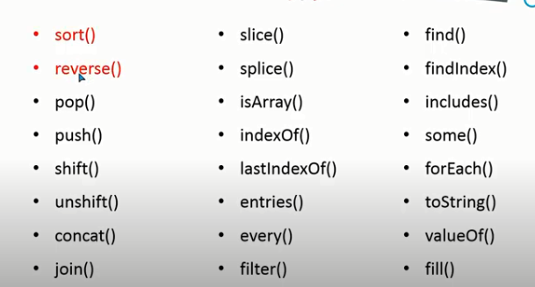
JS Array’s Built in Functions

Slide 32
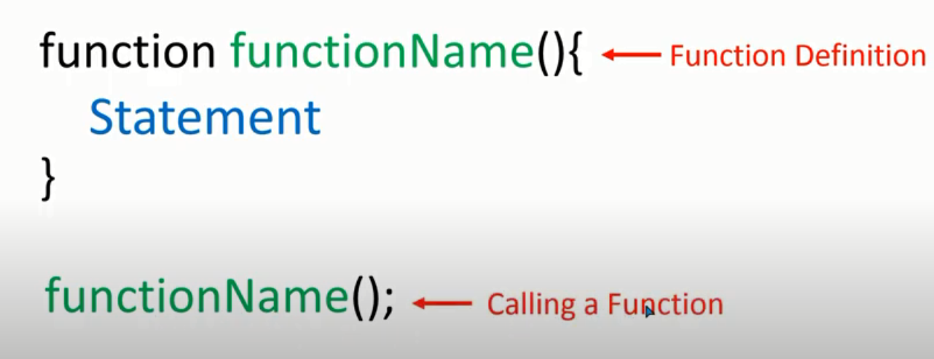
User Define Function in JS

Slide 33
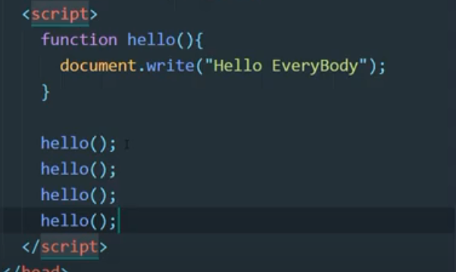
Function Implementation

Slide 34
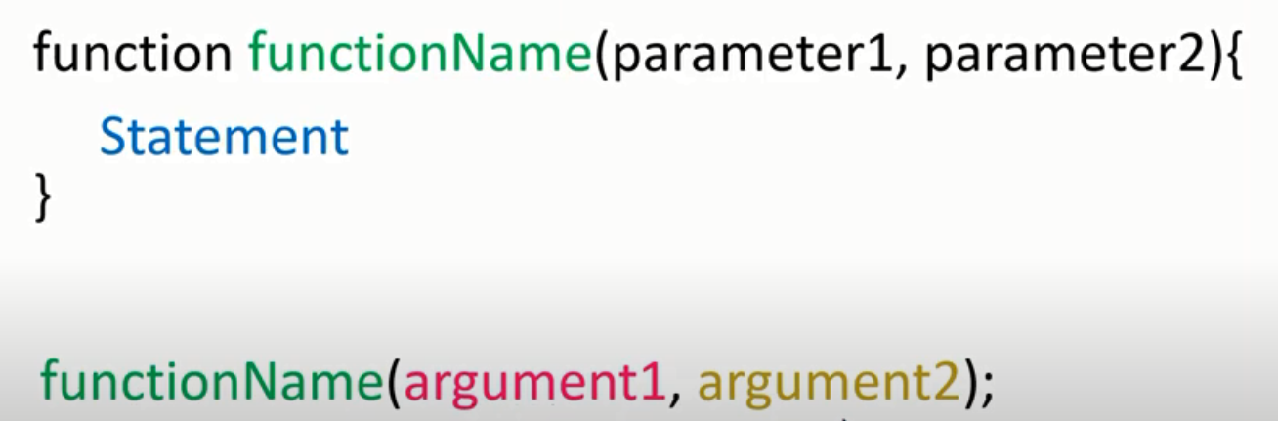
User define function with parameters

Slide 35
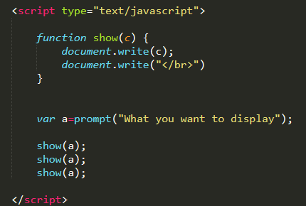

Slide 36
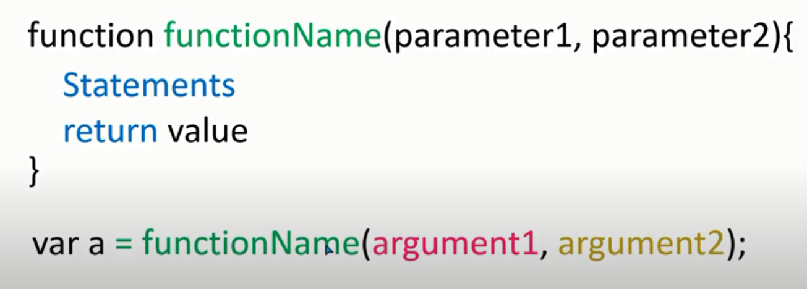
Function with return values

Slide 37
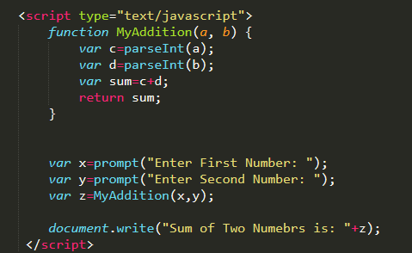
Example code

